Slide 1

Geometry
Unit 3, Lesson 5 Converse of the Alternate Interior Angles Theorem Volume 1, pg. 149

Slide 2


Benchmarks
MA.912.GR.1.1
Prove relationships and theorems about lines and angles. Solve mathematical and real-world problems involving postulates, relationships, and theorems of lines and angles.
MA.912.LT.4.3
Identify and accurately interpret “if…then,” “if and only if,” “all” and “not” statements. Find the converse, inverse, and contrapositive of a statement.
volume 1, pg. 149

Slide 3
Integrated Mathematical Thinking and Reasoning Standards
MA.K12.MTR.1.1 Actively participate in effortful learning both individually and collectively.
MA.K12.MTR.4.1 Engage in discussions that reflect on the mathematical thinking of self and others.
MA.K12.MTR.5.1 Use patterns and structure to help understand and connect mathematical concepts.
MA.K12.MTR.6.1 Assess the reasonableness of solutions.
volume 1, pg. 149

Slide 4

Learning Targets
I can write and use the converse of a postulate or theorem.
I can use postulates and theorems about parallel lines to determine if lines are parallel.
volume 1, pg. 149

Slide 5

Warm-Up
volume 1, pg. 150

Slide 6
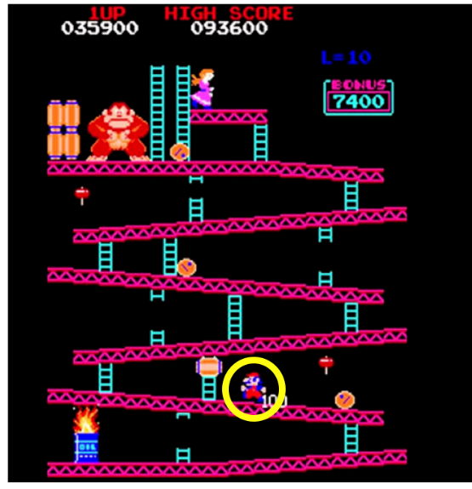
3.5.1 Warm-Up: Notice and Wonder
The game Donkey Kong was released for sale in the U.S. in 1981 by Nintendo, a Japanese playing card and toy company turned video game developer. Mario, circled in yellow, is shown in the image running and climbing up the platforms and ladders.
What do you notice about the different platforms Mario is running on?
What do you wonder?
How can you determine if any of the platforms or ladders are parallel?
volume 1, pg. 150

Slide 7

Exploration
volume 1, pg. 150

Slide 8

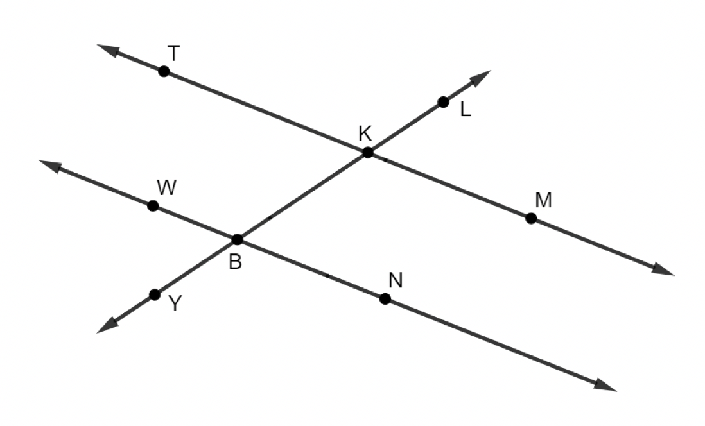

3.5.2 Exploration: Congruent Angles Formed by Two Lines and a Transversal
$\overset{⃡}{TM}$, $\overset{⃡}{WN}$, and $\overset{⃡}{YL}$ are shown. $\overset{⃡}{YL}$ intersects $\overset{⃡}{TM}$and $\overset{⃡}{WN}$.
Work with your partner to conjecture if the given information in each row of the table is sufficient to show that the lines are parallel.
volume 1, pg. 150

Slide 9
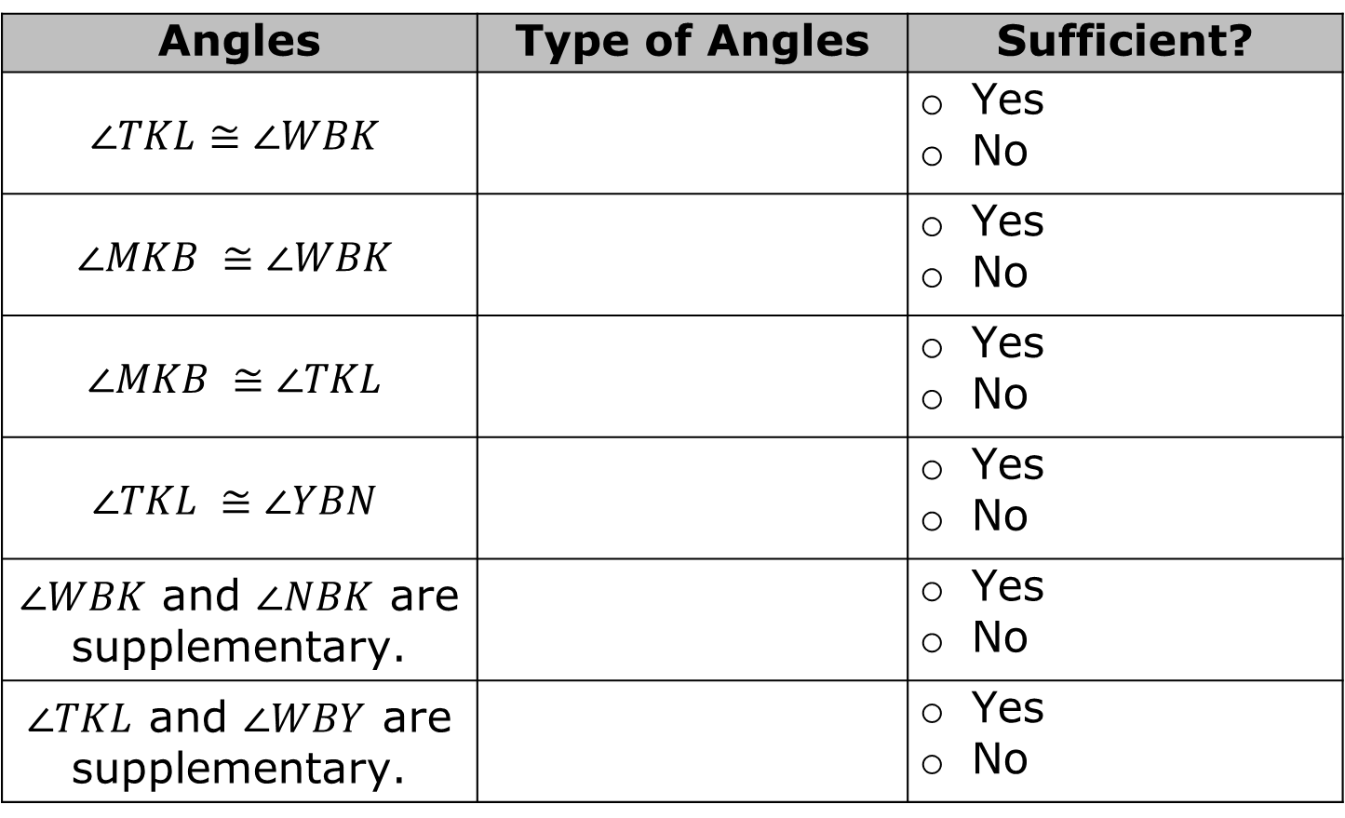
Angles | Type of Angles | Sufficient?
$$∠TKL≅∠WBK$$ |  | Yes No
$$∠MKB ≅∠WBK$$ |  | Yes No
$$∠MKB ≅∠TKL$$ |  | Yes No
$$∠TKL ≅∠YBN$$ |  | Yes No
$∠WBK$ and $∠NBK$ are supplementary. |  | Yes No
$∠TKL$ and $∠WBY$ are supplementary. |  | Yes No
volume 1, pg. 150

Slide 10

Activity
volume 1, pg. 151

Slide 11

3.5.3 Activity: Converses of Parallel Lines Postulates and Theorems
Work with your partner or group to write the converse of the postulate or theorem your group is assigned. Then, draw a picture to represent the relationship described.
Postulate or Theorem | Converse
If two parallel lines are intersected by a transversal, then alternate interior angles are congruent.
Picture
volume 1, pg. 151

Slide 12
Postulate or Theorem | Converse
If two parallel lines are intersected by a transversal, then corresponding angles are congruent.
Picture
volume 1, pg. 151

Slide 13
Postulate or Theorem | Converse
If two parallel lines are intersected by a transversal, then consecutive exterior angles are supplementary.
Picture
volume 1, pg. 151

Slide 14
Postulate or Theorem | Converse
If two parallel lines are intersected by a transversal, then alternate exterior angles are congruent.
Picture
volume 1, pg. 152

Slide 15
Postulate or Theorem | Converse
If two parallel lines are intersected by a transversal, then consecutive interior angles are supplementary.
Picture
volume 1, pg. 152

Slide 16

Guided Practice
volume 1, pg. 152

Slide 17

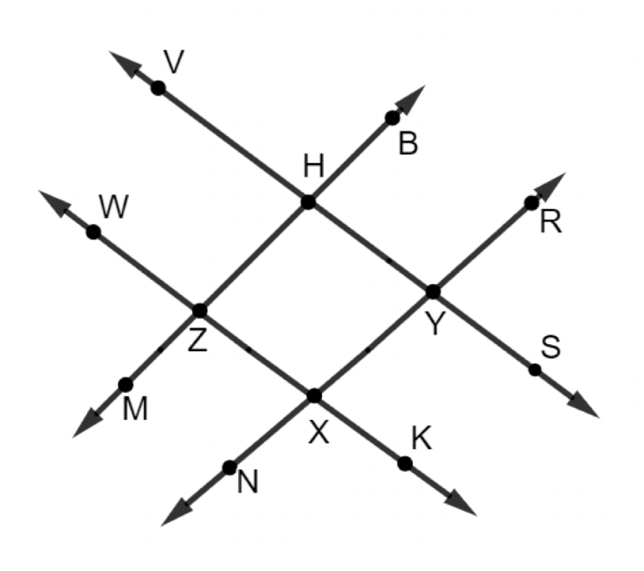
3.5.4 Guided Practice: Determining if Lines are Parallel
$\overset{⃡}{VS}$, $\overset{⃡}{WK}$, $\overset{⃡}{MB}$, and $\overset{⃡}{NR}$ are shown where $m∠VHB=98°$, $m∠RYS=78°$, $m∠NXK=102°$, and $m∠WZM=82°$.
Which pair(s) of lines are parallel? Justify your answer.
volume 1, pg. 152

Slide 18
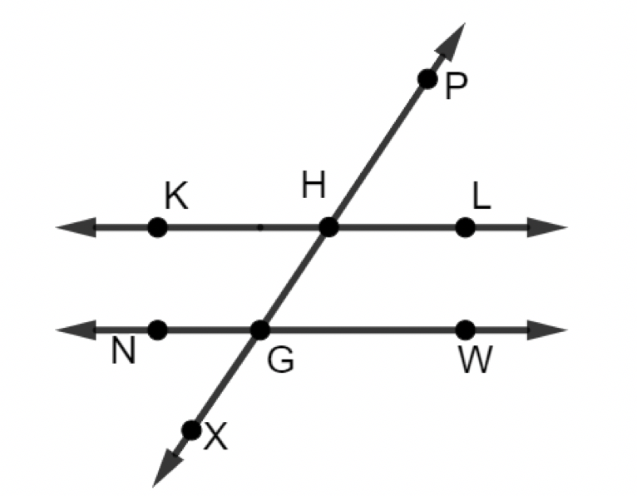
$\overset{⃡}{KL}$, $\overset{⃡}{NW}$, and $\overset{⃡}{PX}$ are shown.
Determine if the given condition could be used to justify that $\overset{⃡}{KL} ∥ \overset{⃡}{NW}$. Then, justify your answer.
volume 1, pg. 153

Slide 19
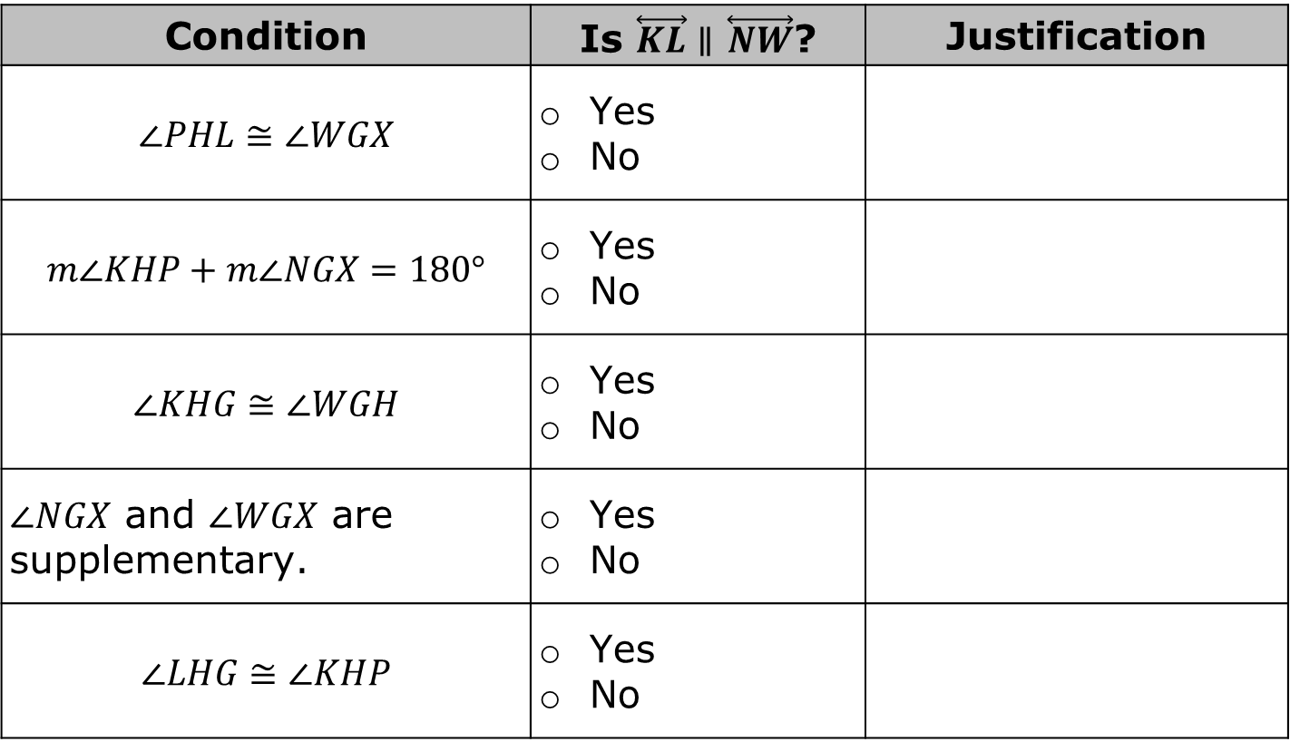
Condition | Is $\overset{⃡}{KL}∥$ $\overset{⃡}{NW}$? | Justification
$$∠PHL≅∠WGX$$ | Yes No
$$m∠KHP+m∠NGX=180°$$ | Yes No
$$∠KHG≅∠WGH$$ | Yes No
$∠NGX$ and $∠WGX$ are supplementary. | Yes No
$$∠LHG≅∠KHP$$ | Yes No
volume 1, pg. 153

Slide 20

Wrap-Up
volume 1, pg. 153

Slide 21
3.5.5 Wrap-Up: Cool Down
Write a short note to a friend who missed today’s class summarizing what you learned.
volume 1, pg. 153

